Slide 1
Expression evaluation using Priority Linked list
Expression resolution by Daipayan

Slide 2
What is Expression Resolver?
Why it is called resolver not evaluation ? Because it tries to resolve the expression using priority first then it starts to do evaluation. What is priority linked list ? A single linked list that has priority field which tells which nodes we have to evaluate first. We can use double linked list also, incase of single linked list we can use prev variable to store the previous node. What is a reduce method ? Reduce will do the evaluation on 3 nodes and compress it into 1 node after evaluation and store it in Register/temporary variable. Why we find the priority of an operator not operand node ? Because we need to know both the variables/operand on left-handside and right handside of an operator to do binary operations like +,-,/,* etc.

Slide 3
Why expression resolver ?
For solving the expression using very easy method
Languages that don’t use pointers can also use this method using references.
Removing the tree datastructure/stack as it makes expression evaluation very complex
For compiler designing using expression resolution to emit assembly instruction in very simple method
For designing calculators in high level languages.

Slide 4
Node structure
struct ListNode { struct ListNode* prev; int isOperatorOrOperand; // tells whether this node is an operator or operand int priority; // priority of the operator and operand struct Symbol *str; // pointer to symbol table for operand char op; // operator variable struct ListNode* next; }; List of operators and priority * 4 / 3 + 2 - 1

Slide 5

Structure of the algorithm
Here each operator or operand are store in a single node, one operand or one operator at a time in a node.
isOperatorOrOperand tells whether it is an operand or operator example:- for ‘+’ , isOperatorOrOperand is 1 for ‘2’, isOperatorOrOperand is 0
Priority for operand is decided by nearby operators example:- a+b*c-d*b, here it will compare the operator of ‘*’ and ‘-’ to decide the priority of operand ‘c’, as ‘*’ has greater priority than ‘-’ so c will be assigned with priority of ‘*’ only.

Slide 6
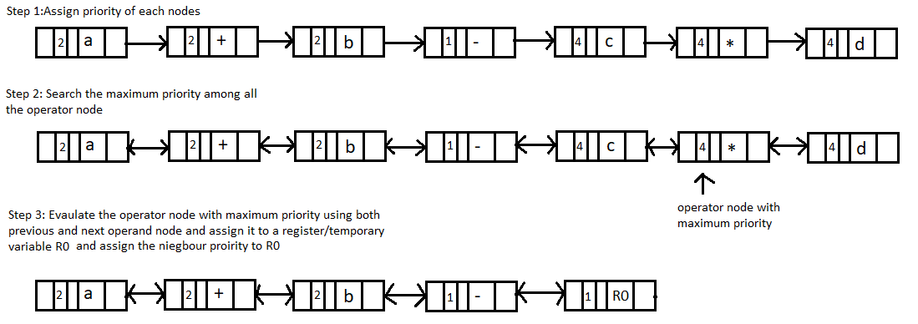
Stepwise Evaluation of Linked List

Slide 7



Stepwise Evaluation of Linked List
Repeat Step 2 Again by finding out the next maximum priority operator here ‘+’ has the maximum priority
Repeat Step 3 Again
Repeat the above procedures until and unless one node remains (head->next == NULL) and return the result when one node is remaining.

Slide 8
How to resolve if braces are there ?
We have a variable defined as blocklevel
on encountering ‘(‘, we increment the blocklevel
on encountering ‘)’, we decrement the blocklevel
we have designed a formula , it is applicable when blocklevel > 0 if(blocklevel > 0) priority = 4*blocklevel+operator_priority; where, operator_priority is given as * 4 / 3 + 2 - 1

Slide 9
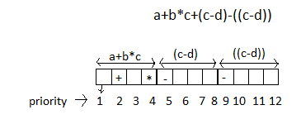
Inside the Formula for braces
if(blocklevel > 0) priority = 4*blocklevel+operator_priority; 4 is added here for expression which are not inside braces and priority for +,-,/* ranges from 1 to 4, example:- a + b *c
Blocklevel determines how many braces inside the expression is, example:- (((a+b))) blocklevel is 3 here
4*Blocklevel + operator_priority tells what should be priority Below example shows how priority values from 1 to 12 is allocated as given for expression ‘a+b*c+(c-d)-((c-d))’

Slide 10
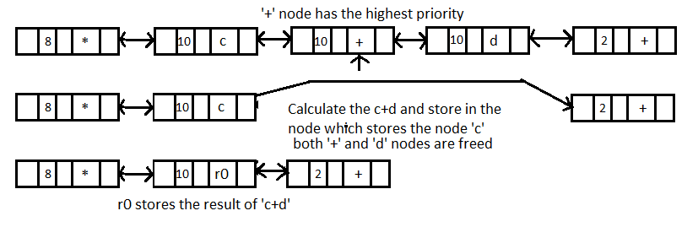
Reduction procedure(reduce)

Slide 11
Stepwise Evaluation of Double Linked List with braces
Braces won’t be inserted inside the linked list, instead we will alter the priority using the formula, if no braces then priority will be based on operator table.
Step 1: Assign priority according to formula for each node
Step 2: go to the highest priority operator node and then calculate c+d and store in R0 register/temp variable

Slide 12

Stepwise Evaluation of Double Linked List with braces
Step 3: goto Maximum priority node and calculate R0*e and assign to R1, take the priority from neighboring node
Step 4: goto Max priority node , calculate a/b and assign to R2 , also take the priority of neighbor for R2 node

Slide 13

Stepwise Evaluation of Double Linked List with braces
Step 5: Terminate the loop as head->next = NULL as only one node is present Fetch the value from R3

Slide 14
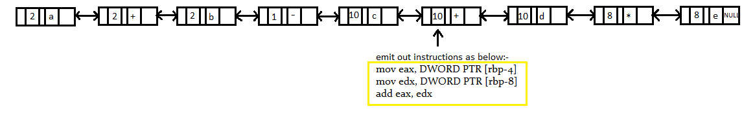
Assembly generation using expression resolver
Step 1: Assign priorities to all the node Step 2: Find the maximum priority among all the node here c+d has maximum priority as 4*2(blocklevel is 2 as 2nd ‘(‘ brace has come) + 2 (priority of ‘+’) = 10
Step 3: emit out the assembly instructions and reduce 3 nodes for ‘c+d’ to one node , result of ‘c+d’ will be stored in eax register and finally erase the right node(‘+’) and current node(‘d’).

Slide 15
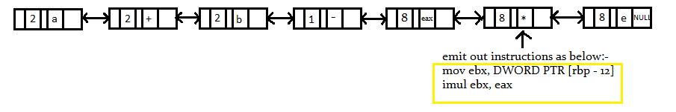
Assembly generation using expression resolver
Step 2 repetition by finding out maximum priority among all the node
Step 3 emit the instructions & erase the right node & current node when no more operator is left then start repetition(Step 1 to Step 3) again.
Repeat all the steps from step 2 to 3 until one node is left after reduction

Slide 16
Code overview
Here we are going to analyze v1.2 code insert() – It is used to encode the operator or operand with priority calculated inside the linked list. For each operator we are inserting using fill() function with operator as DIV_OP & operator type as BINARY_OP we are passing calculating priority as priority + mapBlocklevel(blocklevel) here mapBlocklevel(blocklevel) is for ‘( expr)’ brackets as brackets increases priority else if(*str == '/')
{
priority = DIV_OP;
if(blocklevel > 0)
{ // printf("Symbol founded is %c, priority is %d\n !",*str , priority+mapBlocklevel(blocklevel));
fill(OPERATOR,priority + mapBlocklevel(blocklevel),NULL ,DIV_OP,BINARY_OP);
} else
{
fill(OPERATOR,priority,NULL, DIV_OP,BINARY_OP );
}
return 1;
} blocklevel > 0 condition is present incase ‘(‘ brackets is occurred so priority increases for the expression encapsulated with brackets

Slide 17
Code overview
Here isalpha(*str) checks for conditions in which operands are occurring or not
we will further check if any digit or alphabet is coming or not , it is to recognize the identifier
After this we will search that identifier in our symbol table using symbol search If symbol search successful then we will assign each operand or identifier a priority by looking the nearest operator priority using getNextPriority(), after that we need to move the symbol variable value into register using mov instruction. else if(isalpha(*str))
{ int i=0,index=-1;
s = str;
while(isalpha(*str) || isdigit(*str))
{ str++;
i++;
}
*k+=i-1; // for moving the reading pointer in main() for removing multi-charachter variable ex:-abc not just ex:-a
strncpy(string_c,s,i);
string_c[i]='\0';
string_c[i+1]='\0';
index=Symbol_search(string_c);
if(index != -1)
{
if(priority == INIT_PRIORITY)
priority = getNextPriority(str);
else if(*(str+1) != '\0' && priority < getNextPriority(str) )
priority = getNextPriority(str);
printf("mov %s,%s\n",register_str[symtbl[index].r],symtbl[index].value );
if(blocklevel > 0)
{ fill(OPERAND,priority + mapBlocklevel(blocklevel),&symtbl[index] ,'\0',NULL_OP);
} else
{ fill(OPERAND,priority,&symtbl[index] ,'\0',NULL_OP);
}

Slide 18
Code overview
These below checks only increments and decrements the blocklevel which will increase the expression priority value on open brackets or decrease it on close brackets and priority is also calculated for next operators and operands as brackets binary or unary operations will be isolated from next operations after bracket open or closes. We need to refresh the priority variable as any other identifier that comes in future will need to be assigned a refreshed priority value. else if(*str == '(')
{
blocklevel++;
priority = getNextPriority(str+1);
return 1;
}
else if(*str == ')')
{
blocklevel--;
priority = getNextPriority(str+1);
return 1;
}

Slide 19
Code overview
In main() function you can see that we are doing below operations As we don’t have any register allocation algorithm hence we are manually inserting each identifier or operand with a value and also passing a register value manually. This is used for symbol table initialization.
(code for version 1.3 for assembly output)
char a[]="a";
char b[]="b";
char c[]="c";
char d[]="d";
char a_value[] ="9";
char b_value[] ="3";
char c_value[] ="2";
char d_value[] ="1";
Symbol_insert(a,INT , a_value, ax);
Symbol_insert(b,INT ,b_value, bx);
Symbol_insert(c,INT ,c_value, cx);
Symbol_insert(d,INT ,d_value, dx);
The functionality of symbol insertion and symbol searching is given in next slide

Slide 20
Code overview
void Symbol_insert(char *sym,char typ,char *val,enum Registers rtemp)
{
symtbl[max_sym].symbol =(char*) malloc(sizeof(char)*strlen(sym));
strncpy(symtbl[max_sym].symbol,sym,strlen(sym));
symtbl[max_sym].type = typ;
symtbl[max_sym].value = (char*)malloc(sizeof(char)*strlen(val));
strncpy(symtbl[max_sym].value,val, strlen(sym));
symtbl[max_sym].r = rtemp;
if(reg_count >= 6)
reg_count = reg_count%5;
reg_count++;
max_sym++;
}
int Symbol_search(char *sym)
{
for(int i=0; i<max_sym; i++)
{
if(strcmp(sym,symtbl[i].symbol)==0)
{
return i;
}
}
return -1;
} In Symbol insertion we are storing the symbol in an array of structures and symbol search will do the comparison with the same array of structures to find the symbol.

Slide 21
Code overview
void fill(int isType,int pr, struct Symbol *s, int op,enum Operation opType)
{
struct ListNode *ptr = (struct ListNode*)malloc(sizeof(struct ListNode));
ptr->isOperatorOrOperand = isType;
ptr->priority = pr;
ptr->next = NULL;
ptr->prev = NULL;
if(isType == OPERAND)
{ ptr->str = s;
ptr->type = INT;
ptr->isOperatorOrOperand = OPERAND;
}
else if(isType == OPERATOR)
{ ptr->op = op;
ptr->opType = opType;
ptr->isOperatorOrOperand = OPERATOR;
}
else if(isType == CONST)
{ ptr->str = s;
ptr->type = CONST;
ptr->isOperatorOrOperand = CONST;
}
if(tail == NULL)
{ tail = ptr;
head = ptr;
}
else
{ tail->next =ptr;
ptr->prev = tail;
tail = tail->next;
}
size++;
}
fill() is used to create the linked list with priority fill will distinguish whether is an operand or operator based on that linked list structure will be filled. From if(tail == NULL) condition line we have started creating a linked list the linked list will be accessed using head & tail variable.

Slide 22
Code overview
struct ListNode
{
struct ListNode* prev;
int isOperatorOrOperand;
int priority;
struct Symbol *str;
int op;
enum Operation opType; /* 1 for unary, 2 for binary*/
enum Ty type;
struct ListNode* next;
};
struct ListNode *tail,*head ; // Priority Queue
int size =0;
The Linked list structure that we are filling in fill() looks as given above.

Slide 23
Code overview
enum Priority
{
ZERO_OP,
SUB_OP,
ADD_OP,
DIV_OP,
MUL_OP,
LAST_OP
}; Priority enum is used to give integer value(priority value) to each operator +,-,*,/ The last enum in the list has the highest priority (MUL_OP), the first enum (SUB_OP) has lowest priority.

Slide 24
Code overview
struct ListNode* maximum()
{
int i=size - 1;
int max = -1;
struct ListNode* ptr = head;
struct ListNode* max_ptr= NULL;
//printll();
while(ptr != NULL)
{
if(max < ptr->priority && ptr->isOperatorOrOperand == OPERATOR)
{ max = ptr->priority;
max_ptr = ptr;
// printf("maximum value hit ! %c %d\n", ptr->op, ptr->priority);
}
ptr = ptr->next;
}
// printf("\noperator is %c\n", max_ptr->op);
return max_ptr;
}
Maximum is used to give back the node which has the highest priority, as in expression evaluation the highest priority operation is done first as per BODMAS rule .
We will see use of this in next slide in expr_resolver().

Slide 25
Code overview
Expression resolution function is used to decode/fetch the operator with maximum priority and also the operands on both the side of the operator and do the arithmetic operation with both the operands inside the while loop. void expr_resolver()
{ int sum;
char buffer[64];
struct ListNode* new_ptr;
do
{ struct ListNode* p = maximum();
if(p== NULL) // operation is completed successfully
return; struct ListNode* left_op = p->prev;
struct ListNode* right_op = p->next;
// start the reduce functionality
if(left_op == NULL && right_op == NULL)
return ;
if((left_op == NULL && right_op != NULL) || (left_op != NULL && right_op == NULL))
{
printf("Expression string is wrong !\n");
}
switch(p->op)
{
case '-':
sum = atoi(left_op->str->value) - atoi(right_op->str->value);
break;
case '+':
sum = atoi(left_op->str->value) + atoi(right_op->str->value);
break;
case '/':
sum = atoi(left_op->str->value) / atoi(right_op->str->value);
break;
case '*':
sum = atoi(left_op->str->value) * atoi(right_op->str->value);
break;
}
… continued in next page

Slide 26
Code overview
.. continuation from prev page.. printf("sum is %d!\n", sum);
sprintf(buffer, "%d", sum);
left_op->next = right_op->next;
if(right_op->next != NULL)
right_op->next->prev = left_op;
strcpy(left_op->str->value, buffer);
// Assign the neighbour node priority to out result node left_op
if(left_op->prev != NULL && right_op->next != NULL)
{
if(left_op->prev->priority > right_op->next->priority)
{
left_op->priority = left_op->prev->priority;
}
else
{
left_op->priority = right_op->next->priority;
}
} else if(left_op->prev != NULL)
{
left_op->priority = left_op->prev->priority;
} else if(right_op->next != NULL )
{
left_op->priority = right_op->next->priority;
}
free(right_op);
free(p);
} while(1);
}
First we compare the left of left & right of right priority with each other, then we can see that the neighbor with greatest priority is assigned to the left node as left node stores the result of the arithmetic operations and right operand & current operator both are deleted from memory. While loop will terminate when no more operators are left inside the linked list.

Slide 27
Debugging reference for developers!
Try to insert a new operator for debugging purpose to check the flow of the code, as highlighted below:- insert() {… else if(*str == ‘&')
{
priority = AND_OP;
if(blocklevel > 0)
{ // printf("Symbol founded is %c, priority is %d\n !",*str , priority+mapBlocklevel(blocklevel));
fill(OPERATOR,priority + mapBlocklevel(blocklevel),NULL ,AND_OP,BINARY_OP);
} else
{
fill(OPERATOR,priority,NULL, AND_OP,BINARY_OP );
}
return 1;
} … }

Slide 28
Debugging reference for developers!
enum Priority
{
ZERO_OP,
SUB_OP,
ADD_OP,
DIV_OP,
MUL_OP, AND_OP,
LAST_OP
}; Add the operator in the priority list, so that a corresponding integer value is assigned to the operator.

Slide 29
Debugging reference for developers!
void expr_resolver() { …. // start the reduce functionality
if(left_op == NULL && right_op == NULL)
return ;
if((left_op == NULL && right_op != NULL) || (left_op != NULL && right_op == NULL))
{
printf("Expression string is wrong !\n");
}
switch(p->op)
{
case SUB_OP:
sum = atoi(left_op->str->value) - atoi(right_op->str->value);
break;
case ADD_OP:
sum = atoi(left_op->str->value) + atoi(right_op->str->value);
break;
case DIV_OP:
sum = atoi(left_op->str->value) / atoi(right_op->str->value);
break;
case MUL_OP:
sum = atoi(left_op->str->value) * atoi(right_op->str->value);
break; case AND_OP:
sum = atoi(left_op->str->value) & atoi(right_op->str->value);
break;
}
…. } In expr_resolver() add the case for doing the & operation.

